Slide 1
The Human
Information i/o via
  visual
  auditory
  haptic
  movement channels
Information stored in memory
Information processed and applied

Slide 2
Vision
Two stages in vision
    • physical reception of stimulus
    • processing and interpretation of stimulus

Slide 3
The Eye - physical reception
mechanism for receiving light and transforming it into electrical energy
light reflects from objects
images are focused upside-down on retina
retina contains rods for low light vision and cones for colour vision
ganglion cells (brain!) detect pattern and movement

Slide 4
Interpreting the signal
Size and depth
visual angle indicates how much of view object occupies
(relates to size and distance from eye)
visual acuity is ability to perceive detail (limited)
familiar objects perceived as constant size
(in spite of changes in visual angle when far away)
cues like overlapping help perception of size and depth

Slide 5
Interpreting the signal (cont)
Brightness
subjective reaction to levels of light
affected by luminance of object
measured by just noticeable difference
visual acuity increases with luminance as does flicker
Colour
made up of hue, intensity, saturation
cones sensitive to colour wavelengths
blue acuity is lowest
8% males and 1% females colour blind

Slide 6
Interpreting the signal (cont)
The visual system compensates for:
movement
changes in luminance.
Context is used to resolve ambiguity
Optical illusions sometimes occur due to over compensation

Slide 7
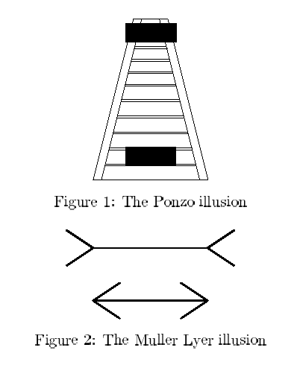
Optical Illusions

Slide 8
Reading
Several stages:
visual pattern perceived
decoded using internal representation of language
interpreted using knowledge of syntax, semantics, pragmatics
Reading involves saccades and fixations
Perception occurs during fixations
Word shape is important to recognition
Negative contrast improves reading from computer screen

Slide 9
Hearing
Provides information about environment:
distances, directions, objects etc.
Physical apparatus:
outer ear - protects inner and amplies sound
middle ear - transmits sound waves as vibrations to inner ear
inner ear - chemical transmitters are released and cause
impulses in auditory nerve.
Sound
pitch - sound frequency
loudness - amplitude
timbre - type or quality

Slide 10
Hearing (cont)
Humans can hear frequencies from 20Hz to 15kHz
less accurate distinguishing high frequencies than low.
Auditory system filters sounds
can attend to sounds over background noise.
for example, the cocktail party phenomenon.

Slide 11
Touch
Provides important feedback about environment.
May be key sense for someone who is visually impaired.
Stimulus received via receptors in the skin:
thermoreceptors - heat and cold
nociceptors - pain
mechanoreceptors - pressure (some instant, some continuous)
Some areas more sensitive than others e.g. fingers.
Kinethesis - awareness of body position
affects comfort and performance.

Slide 12
Movement
Time taken to respond to stimulus: reaction time + movement time
Movement time - dependent on age, fitness etc.
Reaction time - dependent on stimulus type:
visual ~ 200ms
auditory ~ 150 ms
pain ~ 700ms
Increasing reaction time decreases accuracy in the unskilled operator but not in the skilled operator.

Slide 13
Movement (cont)
Fitts' Law describes the time taken to hit a screen target:
Mt = a + b log₂(D/S + 1)
where a and b are empirically determined constants
Mt is movement time
D is Distance
S is Size of target
⇒ targets as large as possible, distances as small as possible

Slide 14
Memory
There are three types of memory function:
Sensory memories (buffers for stimuli: visual → iconic,
auditory → echoic, touch → haptic)
Short-term memory or working memory
Long-term memory
Selection of stimuli governed by level of arousal.
Attention
Rehearsal

Slide 15
Short-term memory (STM)
Scratch-pad for temporary recall
rapid access ~ 70ms
rapid decay ~ 200ms
limited capacity - 7± 2 chunks

Slide 16
Examples
212348278493202
0121 414 2626
HEC ATR ANU PTH ETR EET

Slide 17
Long-term memory (LTM)
Repository for all our knowledge
slow access ~ 1/10 second
slow decay, if any
huge or unlimited capacity
Two types
episodic - serial memory of events
semantic - structured memory of facts,concepts, skills
information in semantic LTM derived from episodic LTM.

Slide 18
Long-term memory (cont.)
Semantic memory structure provides access to information
Represents relationships between bits of information
Supports inference
Model: semantic network
inheritance - child nodes inherit properties of parent nodes
relationships between bits of information explicit
supports inference through inheritance

Slide 19
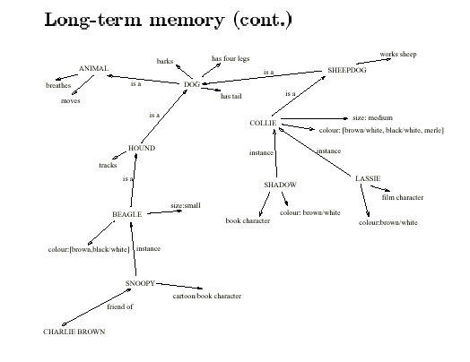
Long-term memory - semantic network

Slide 20
Models of LTM - Frames
Information organized in data structures
Slots in structure instantiated with values for instance of data
Type-subtype relationships
DOG
Fixed
legs: 4
Default
diet: carniverous
sound: bark
Variable
size:
colour
COLLIE
Fixed
breed of: DOG
type: sheepdog
Default
size: 65 cm
Variable
colour

Slide 21
Models of LTM - Scripts
Model of stereotypical information required to interpret situation
Script has elements that can be instantiated with values for context
Script for a visit to the vet
Entry conditions: dog ill
vet open
owner has money
Result: dog better
owner poorer
vet richer
Props: examination table
medicine
instruments
Roles: vet examines
diagnoses
treats
owner brings dog in
pays
takes dog out
Scenes: arriving at reception
waiting in room
examination
paying
Tracks: dog needs medicine
dog needs operation

Slide 22
Models of LTM - Production rules
Representation of procedural knowledge.
Condition/action rules
if condition is matched
then use rule to determine action.
IF dog is wagging tail
THEN pat dog
IF dog is growling
THEN run away

Slide 23
LTM - Storage of information
rehearsal - information moves from STM to LTM
total time hypothesis
- amount retained proportional to rehearsal time:
distribution of practice effect
- optimized by spreading learning over time:
structure, meaning and familiarity - information easier to remember

Slide 24
LTM - Forgetting
decay
information is lost gradually but very slowly
interference
new information replaces old: retroactive interference
old may interfere with new: proactive inhibition
so may not forget at all memory is selective ….
… affected by emotion - can subconsciously `choose' to forget

Slide 25
LTM - retrieval
recall
information reproduced from memory
can be assisted by cues, e.g. categories, imagery
recognition
information gives knowledge that it has been seen before
less complex than recall - information is cue.

Slide 26
Thinking: reasoning and problem solving
Reasoning
Deductive: derive logically necessary conclusion from given premises.
e.g. If it is Friday then she will go to work
It is Friday
Therefore she will go to work.
Logical conclusion not necessarily true:
e.g. If it is raining then the ground is dry
It is raining
Therefore the ground is dry

Slide 27
Deduction (cont.)
Human deduction poor when truth and validity clash
e.g. Some people are babies
Some babies cry
Inference - Some people cry
Correct?
People bring world knowledge to bear

Slide 28
Inductive Reasoning
Inductive: generalize from cases seen to cases unseen
e.g. all elephants we have seen have trunks
therefore all elephants have trunks.
Unreliable: can only prove false not true.
Useful though.
Humans not good at using negative evidence
e.g. Wason's cards.

Slide 29
Wason's cards
7 E 4 K
If a card has a vowel on one side it has an even number on the other
Is this true?
How many cards do you need to turn over to find out?
…. and which cards?

Slide 30
Abductive reasoning
reasoning from event to cause
e.g. Sam drives fast when drunk.
If see Sam driving fast, assume drunk.
Unreliable: can lead to false explanations.

Slide 31
Problem solving
Process of finding solution to unfamiliar task using knowledge.
Several theories.
Gestalt
problem solving both productive and reproductive
productive draws on insight and restructuring of problem
attractive but not enough evidence to explain `insight' etc.
move away from behaviouralism and led towards information
processing theories

Slide 32
Problem solving (cont.)
Problem space theory
problem space comprises problem states
problem solving involves generating states using legal operators
heuristics may be employed to select operators
e.g. means-ends analysis
operates within human information processing system
e.g. STM limits etc.
largely applied to problem solving in well-defined areas
e.g. puzzles rather than knowledge intensive areas

Slide 33
Problem solving (cont.)
Analogy
analogical mapping:
novel problems in new domain?
use knowledge of similar problem from similar domain
analogical mapping difficult if domains are semantically different
Skill acquisition
skilled activity characterized by
chunking - lot of information is chunked to optimize STM
conceptual rather than superficial grouping of problems
- information is structured more effectively

Slide 34
Errors and mental models
Types of error
slips
right intention, but failed to do it right
causes: poor physical skill,inattention etc.
change to aspect of skilled behaviour can cause slip
mistakes
wrong intention
cause: incorrect understanding
- humans create mental models to explain behaviour.
if wrong (different from actual system) errors can occur.

Slide 35
Individual differences
long term - sex, physical and intellectual abilities
short term - effect of stress or fatigue
changing - age
Ask: will design decision exclude section of user population?

Slide 36
Cognitive Psychology and Interactive System Design
Some direct applications
e.g. blue acuity is poor
⇒ blue should not be used for important detail.
However, correct application generally requires understanding of context in psychology, and an understanding of particular experimental conditions
A lot of knowledge has been distilled in
guidelines - see Chapters 4 and 5
cognitive models - see Chapter 6
experimental and analytic evaluation techniques - see Chapter 11

